Slide 1

DS CA-4
Unlocking Equity & Efficiency: A Data-Driven Review of India's Crop Insurance Schemes (2018-2022)
From Raw Data to an Interactive Predictive Dashboard
By- Ameen Khan (22070521007)
Under the Guidance of – Dr. Piyush Chauhan

Slide 2

The Core Finding: A “Vulnerable Farmer Paradox”
📈 Policy Growth (2018–2022)
+80%
Farmer Policies Surged (from ~58M to ~104M)
📉 Financial Coverage
Decline
In Average Insured Sum (Total insured area also declined concurrently)
Key Insight: 81.1% of beneficiaries are Small and Marginal Farmers, who insure smaller, less valuable plots.
Takeaway: The scheme is succeeding in reach but struggling with financial depth.

Slide 3

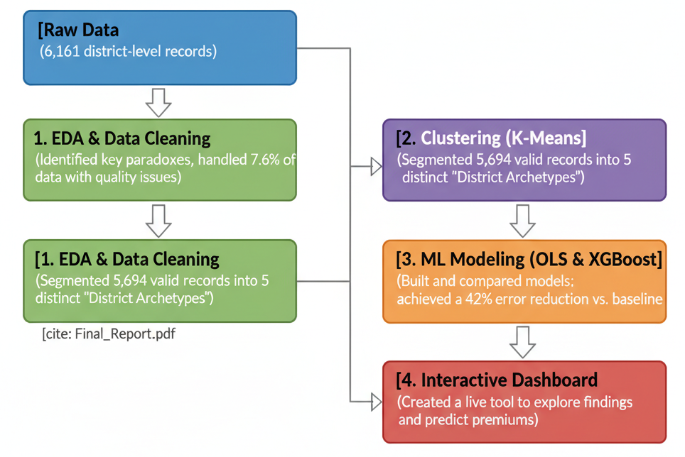

An End-to-End Data Science Project
This wasn't just a static analysis; it was the creation of a complete data product.

Slide 4
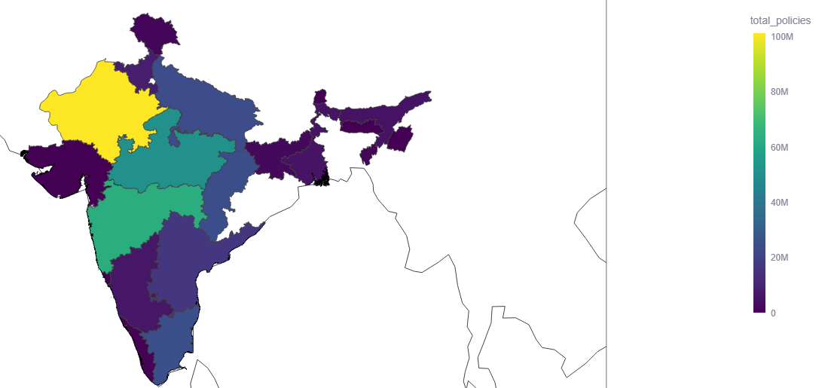
Finding 1: The 'Insurance Heartland' (EDA)
The Key Insights:
1. Insurance activity is not uniform.
The data proves that participation is highly concentrated in a few key regions.
2. A High-Volume “Insurance Heartland” Exists.
As the map shows, Maharashtra, Rajasthan, and Madhya Pradesh dominate national participation.
3. Policy “Hotspots” Emerge.
Individual districts like Hanumangarh and Beed are massive outliers, showing more policy volume than entire states.
A "one-size-fits-all" policy is inefficient. The data proves we need a regional, data-driven strategy.

Slide 5
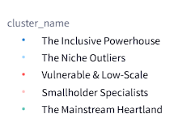
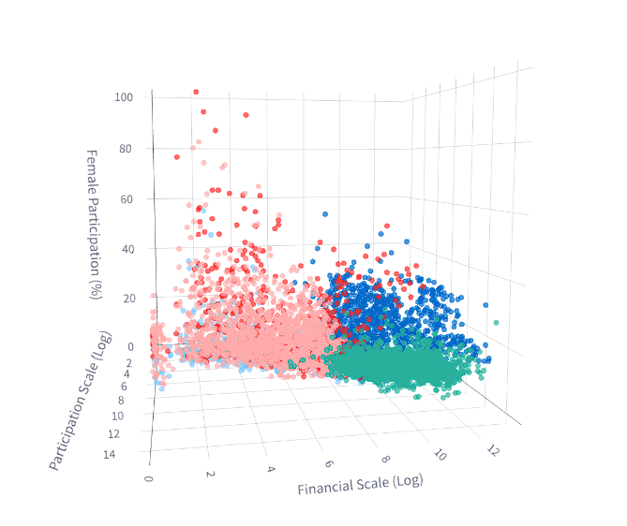
Finding 2: The 5 District 'Archetypes' (Clustering)
Cluster 1: The Mainstream Heartland
The largest group, defined by high financial and area scale but the lowest female participation (9.98%). Common in Madhya Pradesh.
Cluster 3: The Inclusive Powerhouse
High-scale districts, but dominated by small farmers (82%) and boasting the highest female participation (21%). Common in Maharashtra.
Cluster 0: Smallholder Specialists
Districts with low financial value (avg. sum ₹517) but decent participation from small farmers (75%). Common in Chhattisgarh.
Cluster 4: Vulnerable & Low-Scale
Defined by the highest rate of marginal farmers (51.85%). These are vulnerable districts that have not yet reached large scale.
Cluster 2: The Niche Outliers
The smallest group, defined by the WBCIS scheme. Has the lowest participation and inclusivity metrics across the board.

Slide 6
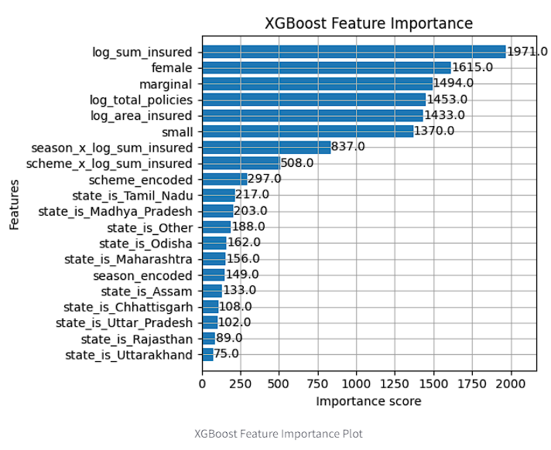
Finding 3: The "Wow" Insight (from Machine Learning)
Social Equity = A Critical Financial Indicator
Our most accurate predictive model (XGBoost) was 24% more accurate than the standard regression model
The model's #1 predictor was clearly log_sum_insured, which we expected.
The "Wow" Insight: The model ranked % Female and % Marginal farmers as the #2 and #3 most important features for predicting a district's premium
These demographic factors were more predictive than total_policies or area_insured.
This proves that social inclusivity is a critical financial predictor, not just a social goal. The model needed this data to make its most accurate predictions.

Slide 7
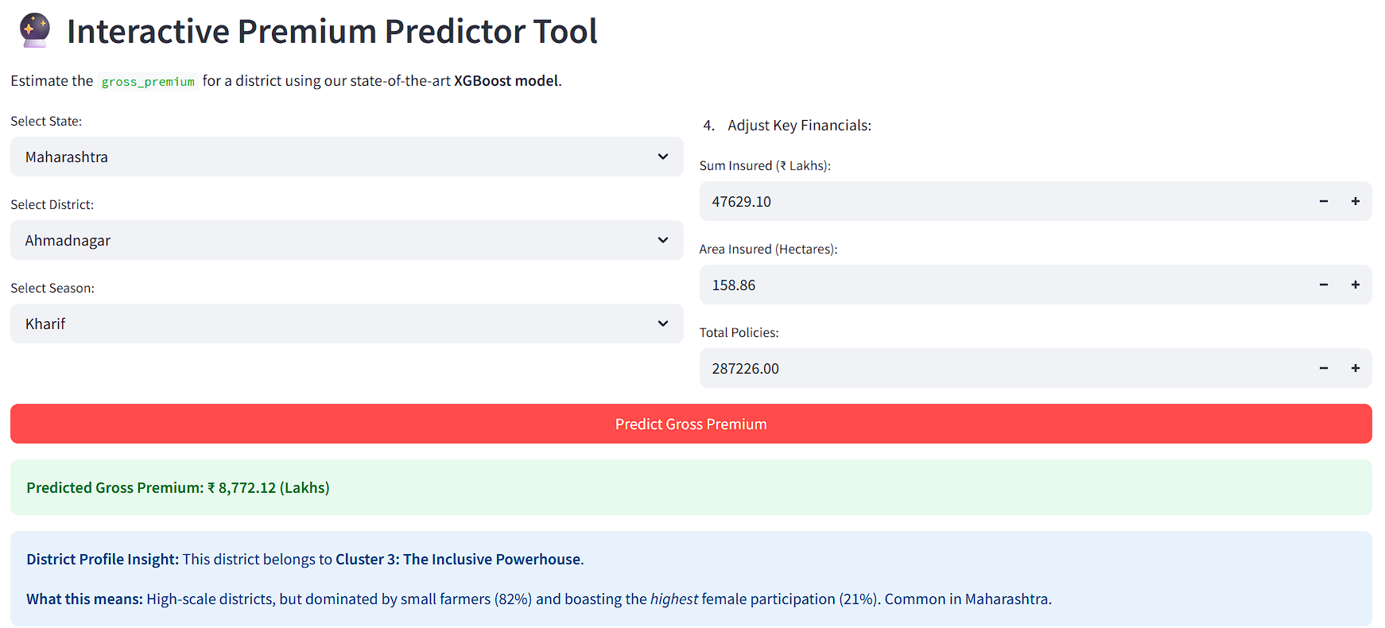
The "Premium Predictor"
It takes all our work—our EDA, our advanced clustering, and our state-of-the-art XGBoost model—and puts it into one practical tool. It doesn't just give you a number. It also tells you why, by showing you the 'District Profile Insight' and connecting the prediction back to the cluster we found. It's the final link between our analysis and a real-world decision.

Slide 8
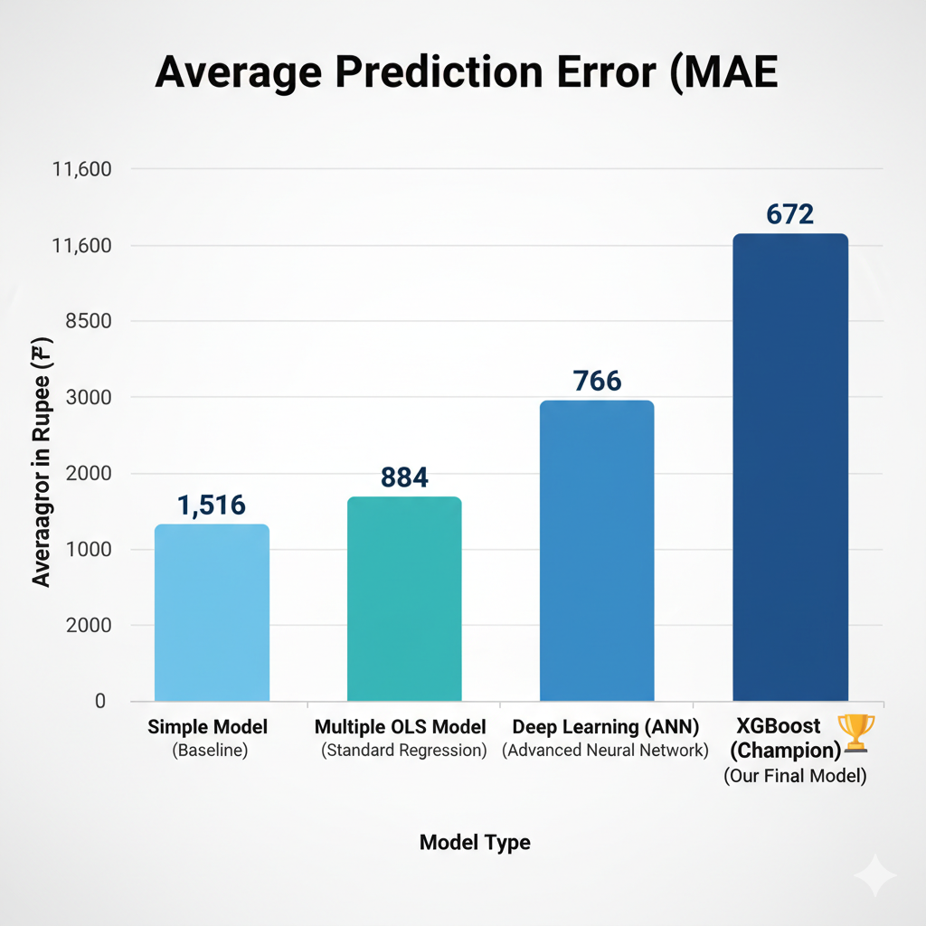
The Model's Journey: A 4-Way Model Showdown
)
Why XGBoost Won the "Experiment"
Step 1: The OLS model (MAE: ₹884) easily beat the simple baseline.
Step 2 (The Experiment): We tested OLS against an advanced Deep Learning (ANN) model.
Step 3 (The Result): The Deep Learning model (MAE: ₹766) successfully beat OLS, proving the data has complex, non-linear patterns.
Step 4 (The Champion): Our XGBoost model (MAE: ₹672) beat every other model, including Deep Learning.
Our final model is 55.7% more accurate than the simple baseline. We achieved this by systematically finding new patterns (like clusters) and adding them to the model.

Slide 9
Conclusion & Recommendations
Grand Finding:
India's crop insurance landscape is defined by two dominant, independent dimensions: Financial Scale and Demographic Inclusivity.
The PMFBY scheme has succeeded on scale but struggles with inclusivity.
Key Recommendations:
Move Beyond "One-Size-Fits-All" Policy: Policy must be data-driven and regional. Use the 5 District Archetypes we found to design targeted strategies for "Inclusive Powerhouses" vs. "Vulnerable" districts.
Treat Equity as a Financial Indicator: Our ML model proved that female and marginal farmer participation are critical predictors of a district's financial profile, not just a social goal.
Future Work:
The clear next step is to integrate claims data.
This would allow us to build the most valuable tool of all: a Loss Ratio & Financial Risk Prediction Model to identify which districts are most likely to need payouts before a disaster hits.

Slide 10
THANK YOU

